Slide 1
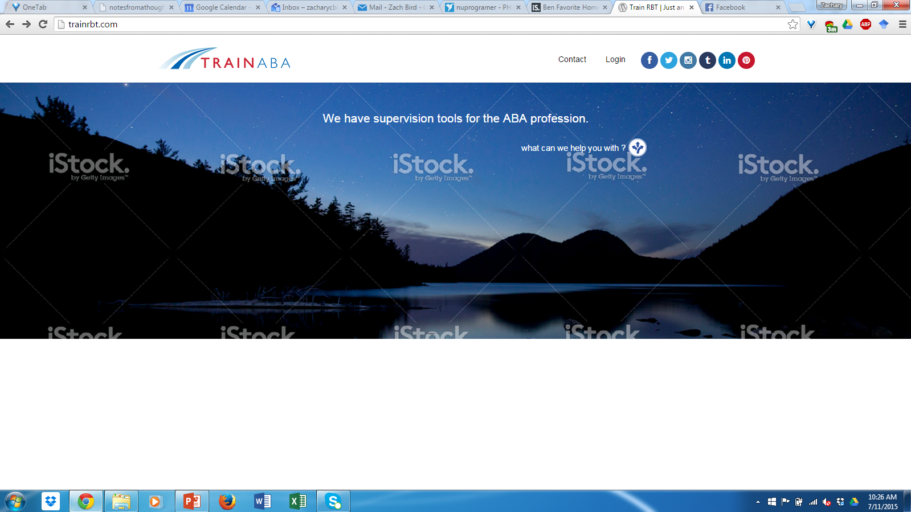



HOME PAGE - Website we want.
Micro-video Supervision tools CEU webinars Contact us
We’re an independent organizational development firm that helps companies build, manage, and develop behavioral teams such as behavior technicians, BCBA exam-candidates, and BCBA supervisors.
Our turnkey learning website and content management system is based on micro-video. Curious to learn more? Let’s chat.
What can we help you with?
+

Slide 2
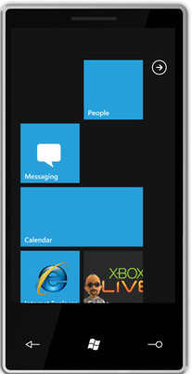


HOME PAGE – Responsive design
We’re an independent organizational development firm that helps companies build, manage, and develop behavioral teams such as behavior technicians, BCBA exam-candidates, and BCBA supervisors.
Our turnkey learning website and content management system is based on micro-video. Curious to learn more? Let’s chat.
What can we help you with?
+

Slide 3
HOME PAGE – Responsive design
Click
We’re an independent organizational development firm that helps companies build, manage, and develop behavioral teams such as behavior technicians, BCBA exam-candidates, and BCBA supervisors.
Our turnkey learning website and content management system is based on micro-video. Curious to learn more? Let’s chat.
What can we help you with?
+

Slide 4
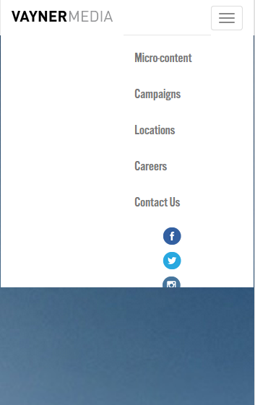

HOME PAGE – Responsive design
We’re an independent organizational development firm that helps companies build, manage, and develop behavioral teams such as behavior technicians, BCBA exam-candidates, and BCBA supervisors.
Our turnkey learning website and content management system is based on micro-video. Curious to learn more? Let’s chat.
What can we help you with?
+

Slide 5


HOME PAGE – Responsive design
Click
What can we help you with?
+
We’re an independent organizational development firm that helps companies build, manage, and develop behavioral teams such as behavior technicians, BCBA exam-candidates, and BCBA supervisors.
Our turnkey learning website and content management system is based on micro-video. Curious to learn more? Let’s chat.

Slide 6
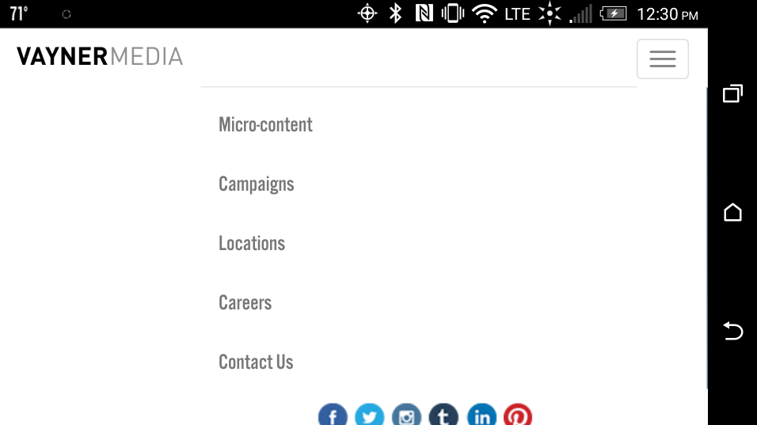

http://simplehomesolar.com/backoffice/
HOME PAGE – Responsive design
What can we help you with?
+
We’re an independent organizational development firm that helps companies build, manage, and develop behavioral teams such as behavior technicians, BCBA exam-candidates, and BCBA supervisors.
Our turnkey learning website and content management system is based on micro-video. Curious to learn more? Let’s chat.

Slide 7
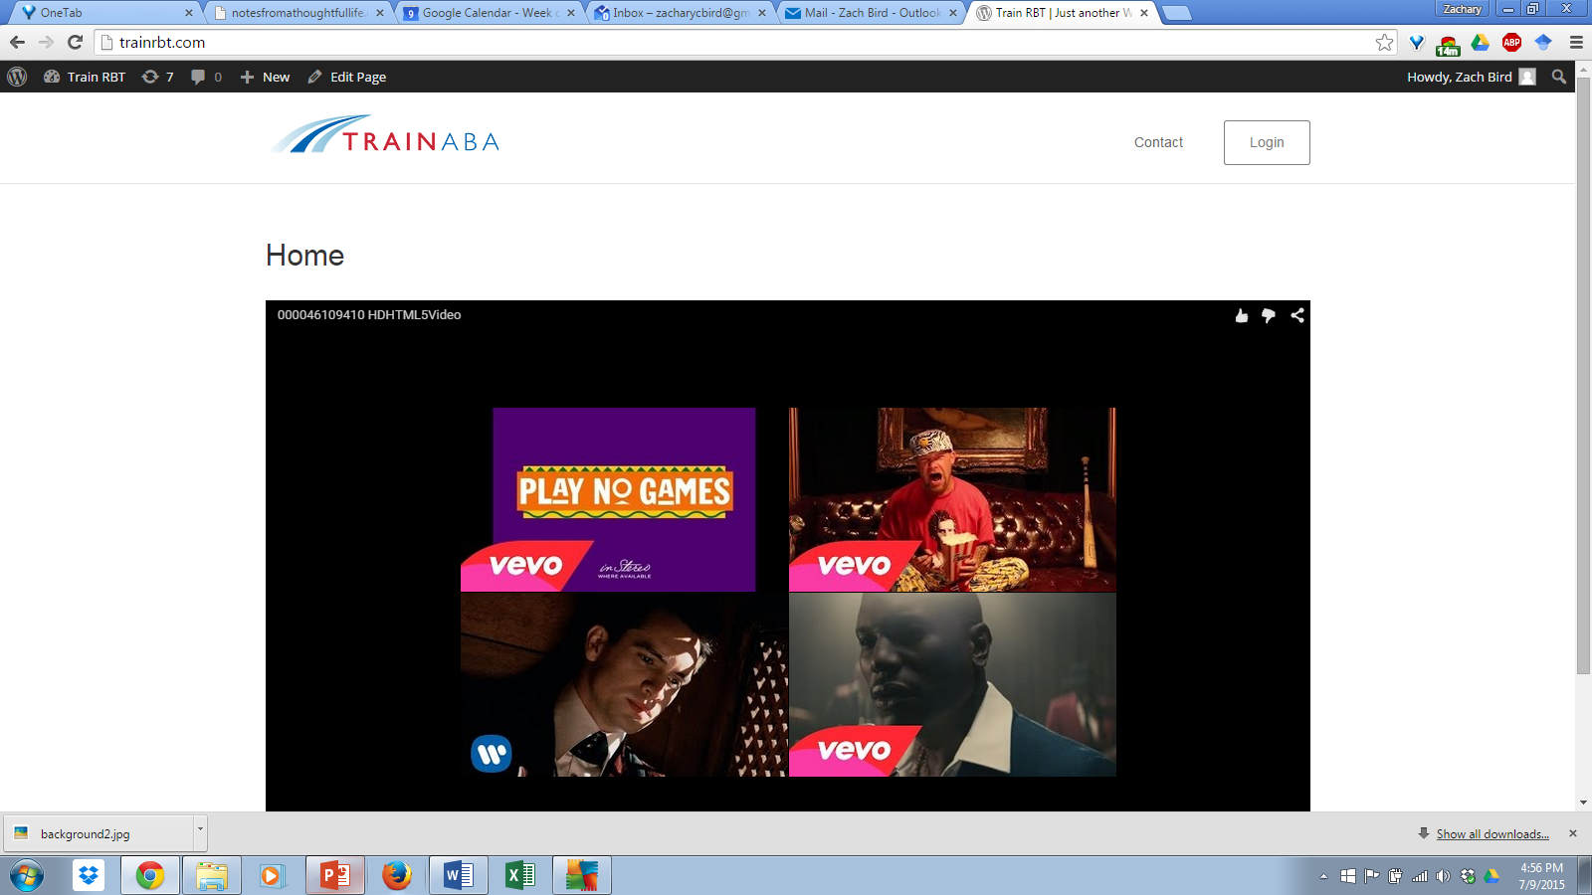


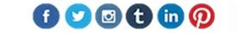
SALES PAGE - Website we want to have developed.
Supervised fieldwork. Solved.
#abainternship
Supervisor Guide
Intern Workbook
Quantity
Quantity
X $35.00
X $35.00
Add to Cart

Slide 8
SALES PAGE - Website we want to have developed.
Video from Vimeo
Supervised fieldwork. Solved.
#abainternship
Supervisor Guide
Intern Workbook
Quantity
Quantity
X $35.00
X $35.00
Add to Cart

